Slide 1

Microsoft Azure Webinar Series: Getting Started with Azure David Gristwood - davidgri@microsoft.com Mike Ormond - mormond@microsoft.com slides: github.com/dxuk/AzureWebinars

Slide 2
Why the Cloud?
Rapidly setup environments to drive business priorities
Scale to meet peak demands
Increase efficiency and reduced cost.
Speed
Scale
Economics

Slide 3
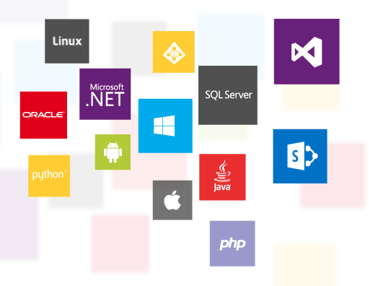
What is Microsoft Azure?
An open and flexible cloud platform
Rapidly build, deploy and manage secure applications to scale
Leverage current skills and the world’s most popular languages, tools, and frameworks
Deploy applications on our secure and reliable global datacenter network or your own on-premise datacenter

Slide 4




















































Platform Services
Security & Management
Compute
Web and Mobile
Developer Services
Hybrid
Operations
Cloud
Services
Service
Fabric
Web Apps
API
Apps
API
Management
Visual Studio
Azure SDK
Portal
Azure AD
Connect Health
Batch
Remote App
Mobile
Apps
Logic
Apps
Notification
Hubs
Team Project
Application
Insights
Active
Directory
AD Privileged
Identity
Management
Multi-Factor
Authentication
Integration
Analytics & IoT
Data
Backup
Storage
Queues
Biztalk
Services
Automation
HDInsight
Machine
Learning
SQL
Database
SQL Data
Warehouse
Operational
Insights
Hybrid
Connections
Service
Bus
Key Vault
Data
Factory
Event
Hubs
Redis
Cache
Search
Import/Export
Store /
Marketplace
Media & CDN
Site
Recovery
Stream
Analytics
Mobile
Engagement
DocumentDB
Tables
VM Image Gallery
& VM Depot
Media
Services
Content Delivery
Network (CDN)
StorSimple
Infrastructure Services
Compute
Storage
Networking
Virtual Machines
Containers
BLOB Storage
Azure Files
Premium Storage
Virtual Network
Load Balancer
DNS
Express
Route
Traffic Manager
VPN Gateway
Application Gateway
Datacenter Infrastructure (38 Regions)

Slide 5
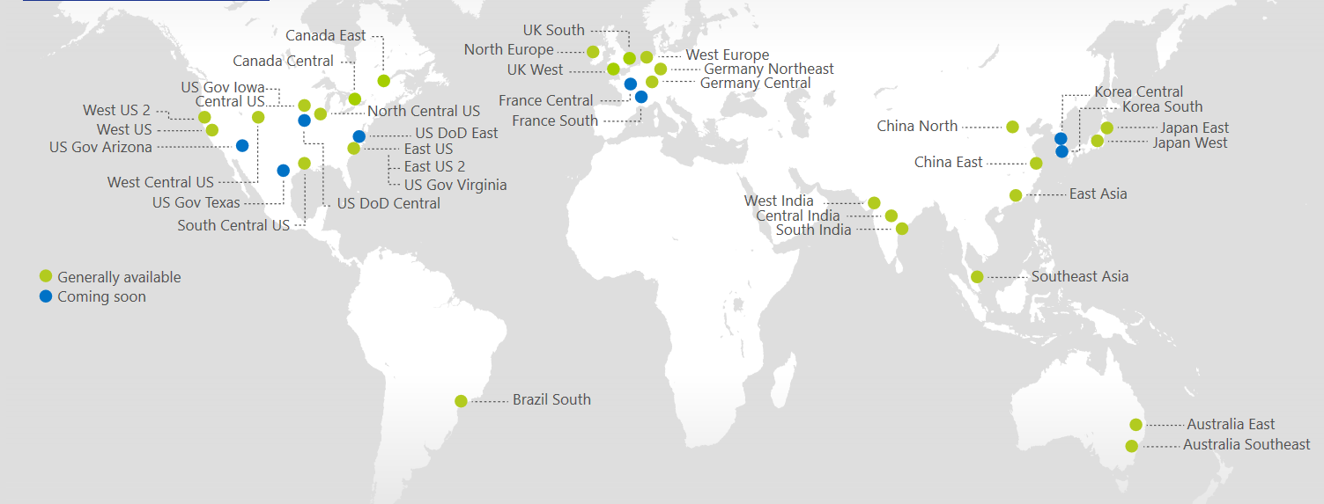
Azure Regions
https://azure.microsoft.com/regions/
Azure is generally available in 30 regions around the world, and has announced plans for 8 additional regions

Slide 6
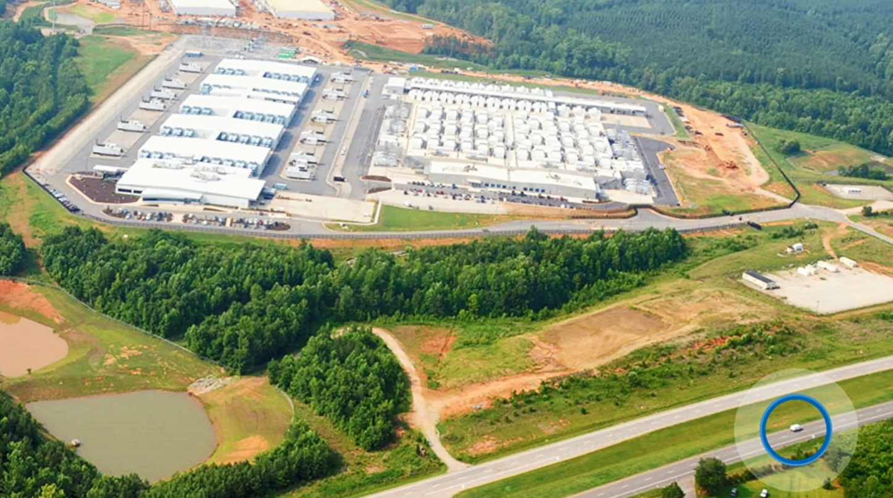

Slide 7
Infrastructure as a Service

Slide 8
The Hybrid Datacenter
Azure
Scale
Pay for what you use
Simple Dev / Test
Fast Provisioning
Integrated Operations
Automate
On-Premises Datacenter

Slide 9

IaaS
Network
Compute
Storage

Slide 10
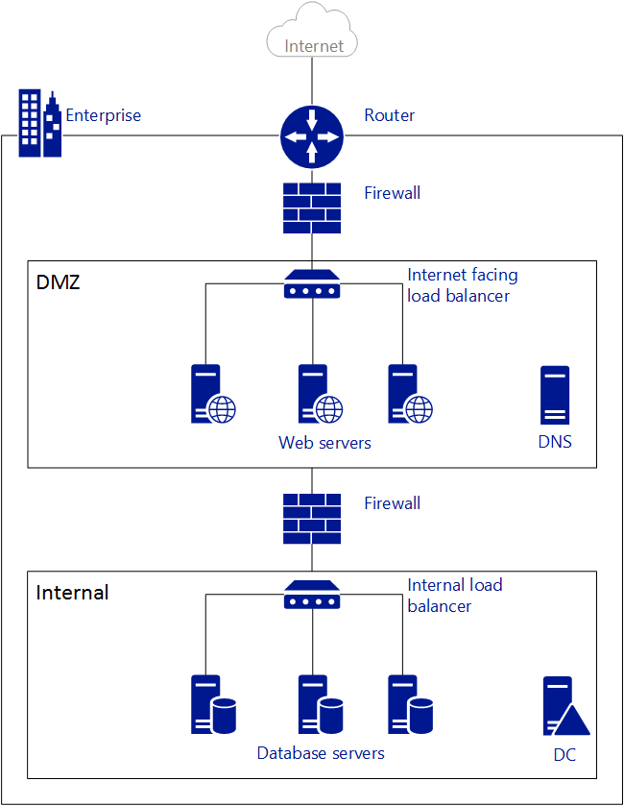
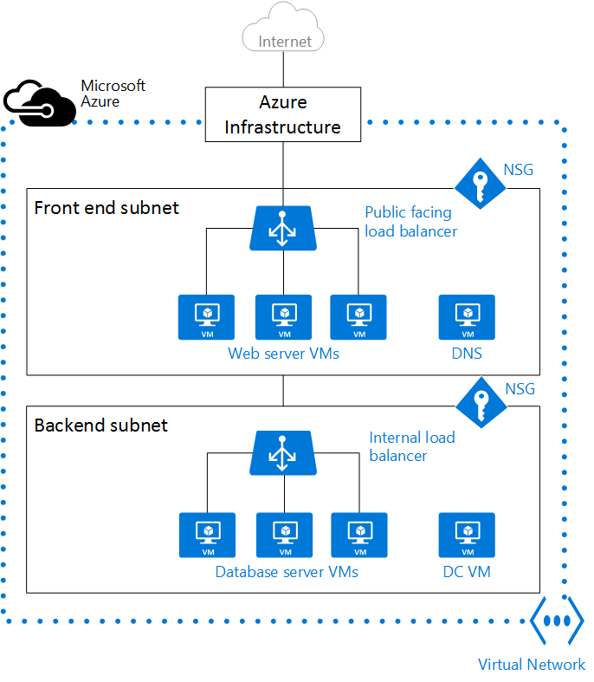
Networking
On Premise
Azure

Slide 11
Networking
On Premise Network | Azure Network
Router device | Azure infrastructure
Firewall appliance | Network Security Group (NSG)
Load Balancer device | Azure load balancer
Virtual Networks (VNet) provide network isolation
- NSG define security boundaries
- Traffic entering / leaving resources in a VNet controlled with NSG
- Resources have access to public internet by default
- Resources within a VNet can communicate using private IP addresses
VNets can be connected to each other and to on-premise datacentres
- Vnet peering or network gateway
- Site to site VPN or ExpressRoute

Slide 12
Compute
Family | Description
A-series | cost-effective, general purpose compute
D(S) -series | cost-effective, general purpose compute (faster CPU and local SSD)
F(s)-series | best value compute capability per core, lower memory footprint
G(S)-series | highest memory footprint
H-series | very high end workloads (eg CFD)
N-series | GPU-enabled. NV for visualisation, NC for compute
All apart from A-series have an SSD temporary disk (D:\)
‘S’ indicates premium storage option (ie SSD for OS / Data drives)
- eg D1 (HDD) vs DS1 (SSD)
For some families there is a “v2” eg Dv2 or DSv2
- This represents the next iteration, typically better specification
Machine family and size determine price
Not all machine sizes are available in all regions

Slide 13
Compute Families Examples
A2v2 or “Standard_A2_v2”
2 CPU cores, 4GB Memory
20GB local SSD
Limit of 4 data disks
No premium storage option
A
DS4 or “Standard_DS4”
8 CPU cores, 28GB Memory
56GB local SSD
Limit of 16 data disks
Premium storage option
D

Slide 14
Storage and Virtual Machines
Azure Virtual Machine
C:\
OS Disk
D:\
Temporary Disk
(Contents can be lost)
E:\, F:\, etc.
Data Disks
Azure Blob
Storage
Standard
Premium (SSD)

Slide 15

Availability & Scaling
Availability Set
Scale Set
Virtual Machine
Virtual Machine
Auto scale set of VMs
No pre-provisioning
Implicit availability set
1
SQL Server
Primary
SQL Server
Secondary
1
2
n
SLA 99.95
Deploy across fault / update domains

Slide 16
Platform as a Service

Slide 17
Platform as a Service
We provide services your application can use
We manage, maintain, upgrade, scale and generally look after these service automatically
You pay only for what you use
Very much along the ideas of microservice design, serverless computing
Popular ones:
Azure App Services for web sites
Azure SQL Database for SQL Server
Azure Functions for event code

Slide 18
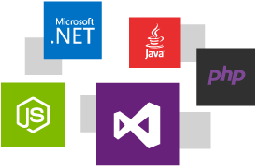
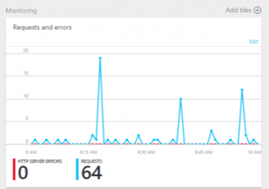
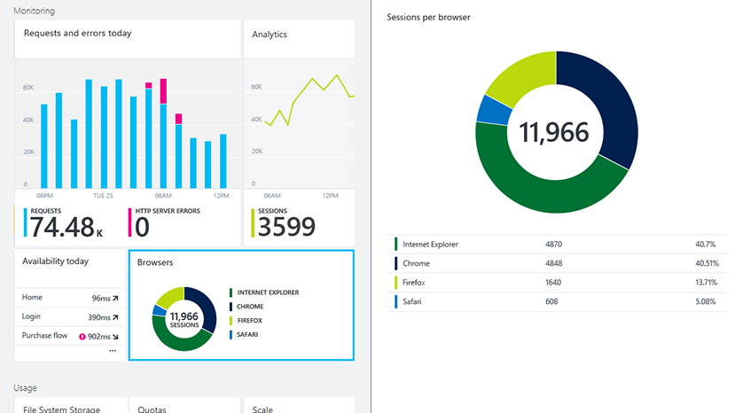
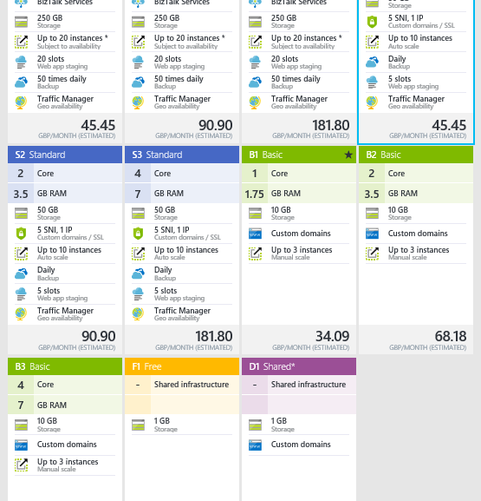
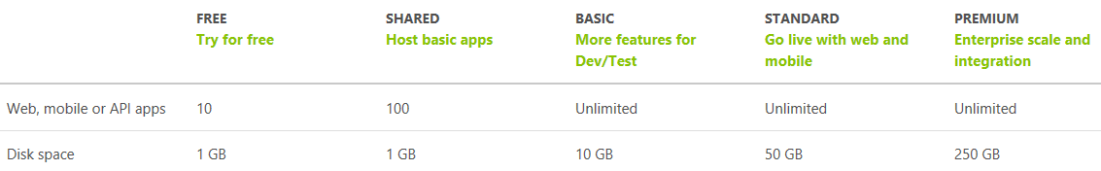
Azure App Services
Web site as a service
+ Web APIs and more
Auto-scale, monitoring, …
Pay for the functionality you need

Slide 19
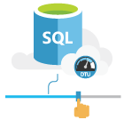
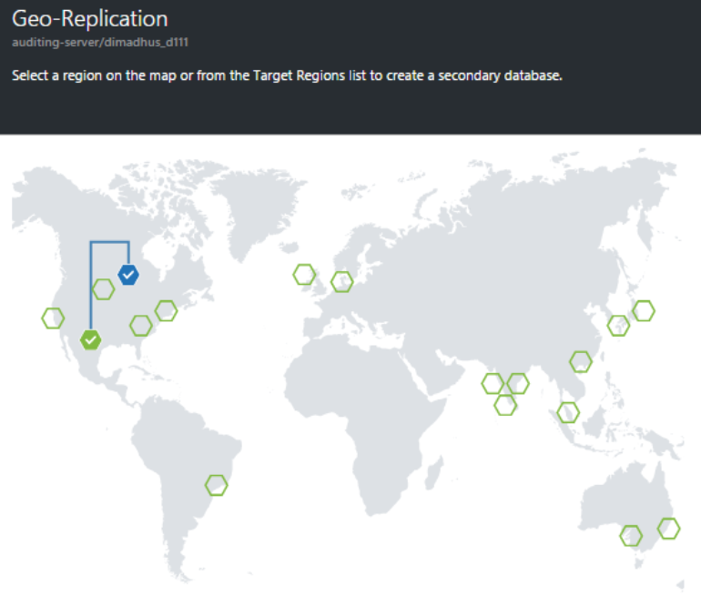
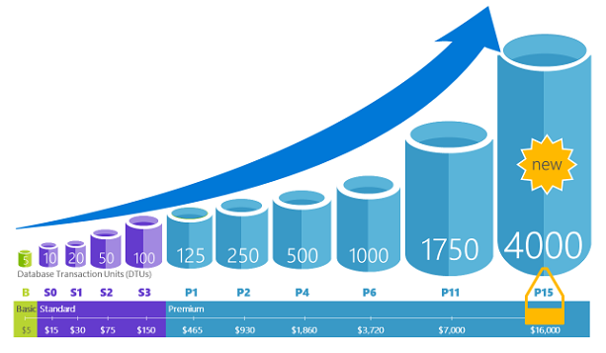
SQL Database
Database as a service
Service Tiers & Performance Levels to match needs
Geo-replicate, restore points…
Elastic pools for efficient multi-tenant
DTU is a blended measure of CPU, memory, and data I/O and transaction log I/O in a ratio determined by an OLTP benchmark workload designed to be typical of real-world OLTP workloads

Slide 20
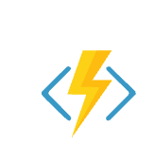
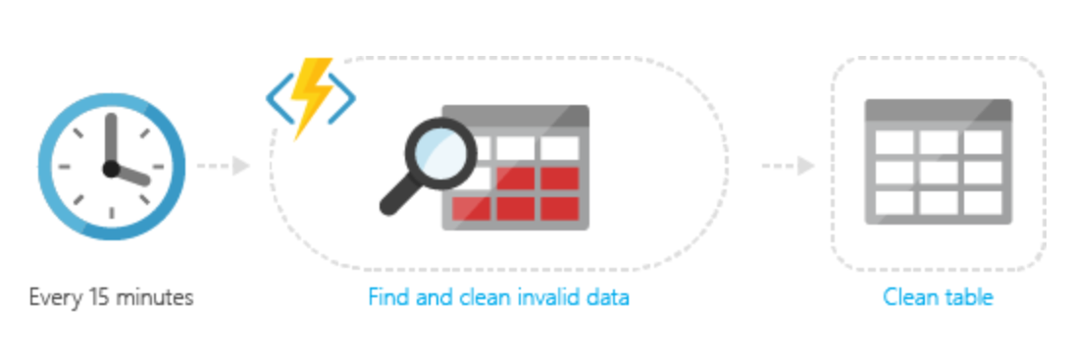
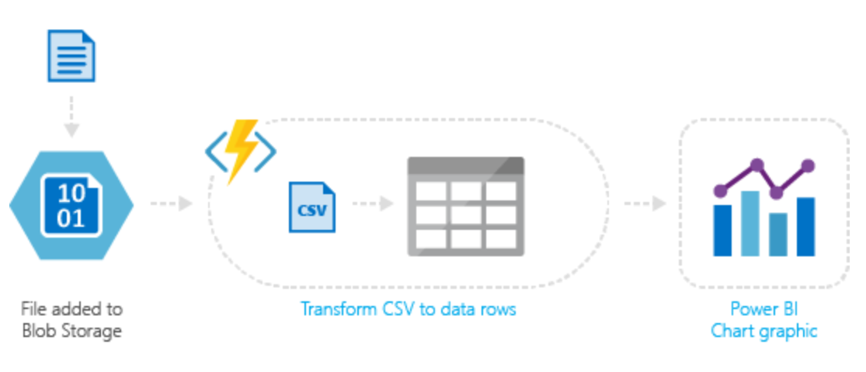
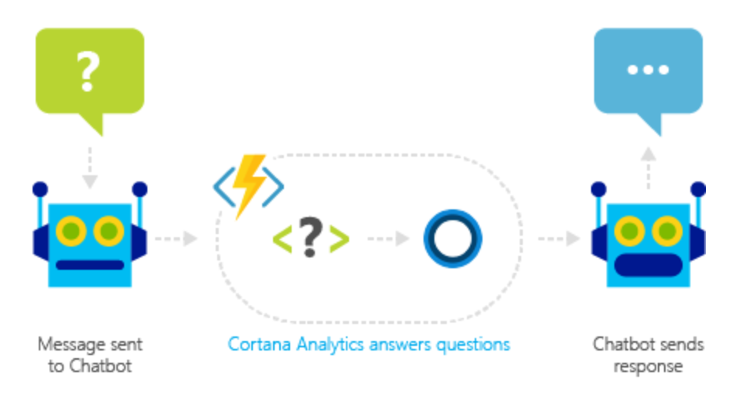
Azure Functions
Process events with a serverless code architecture
Event driven model
Pay only for what you use
JavaScript, C#, Python, PHP, Bash, Batch, and PowerShell

Slide 21
Azure Portal

Slide 22
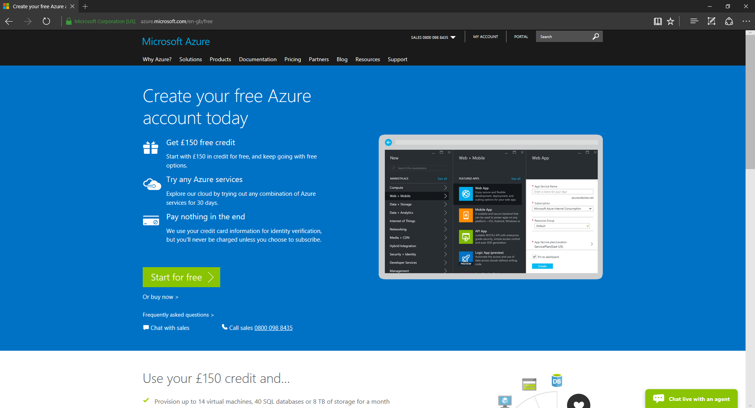
https://azure.microsoft.com/free/

Slide 23
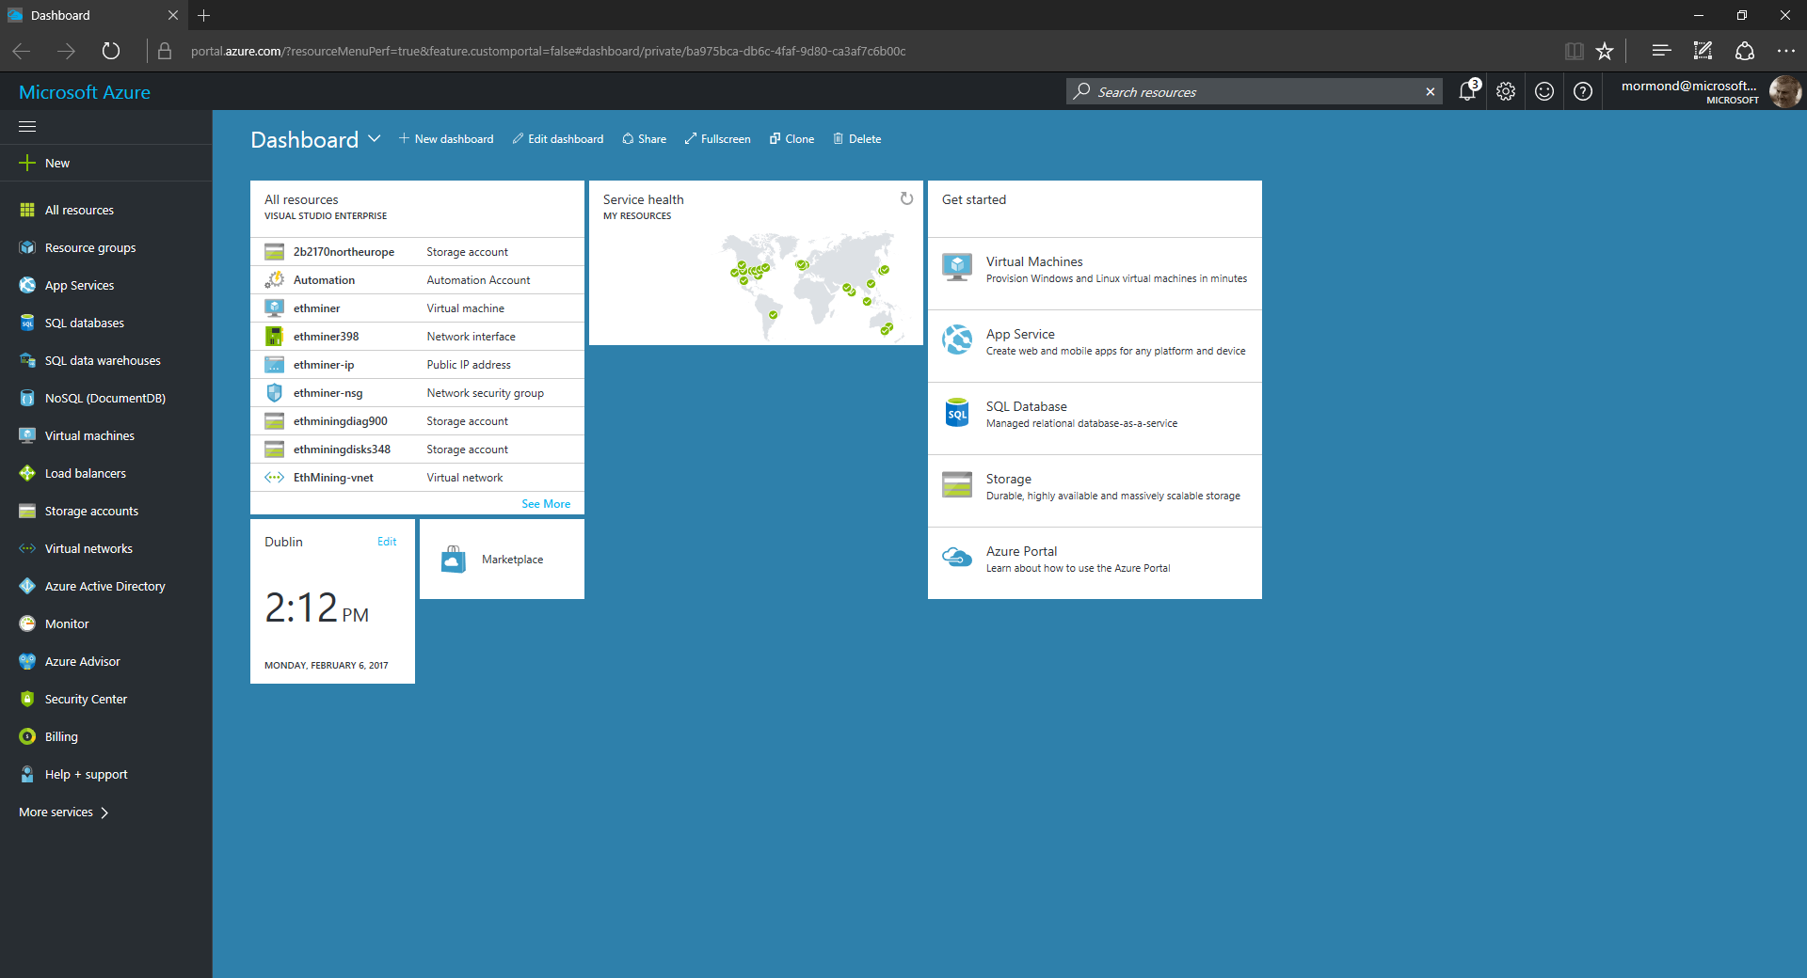
3
2
1

Slide 24
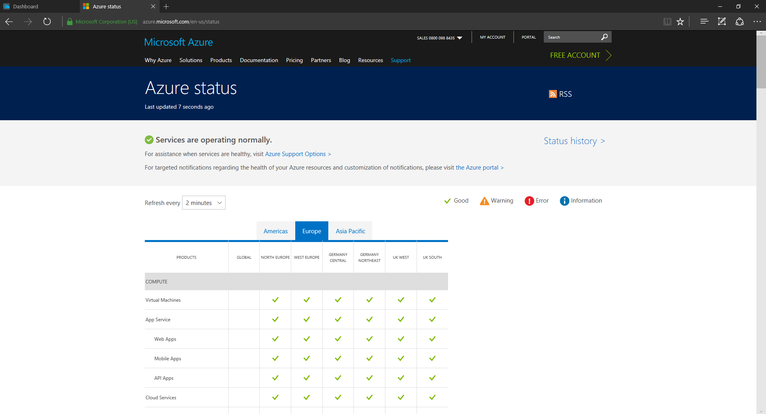
https://azure.microsoft.com/status/

Slide 25
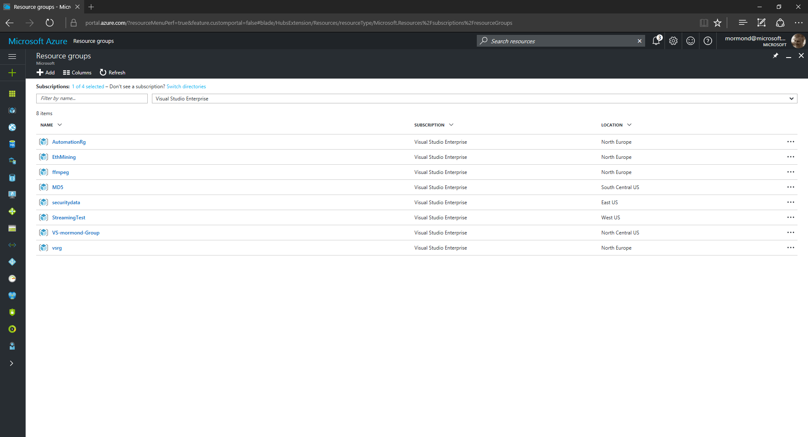

Slide 26


Slide 27
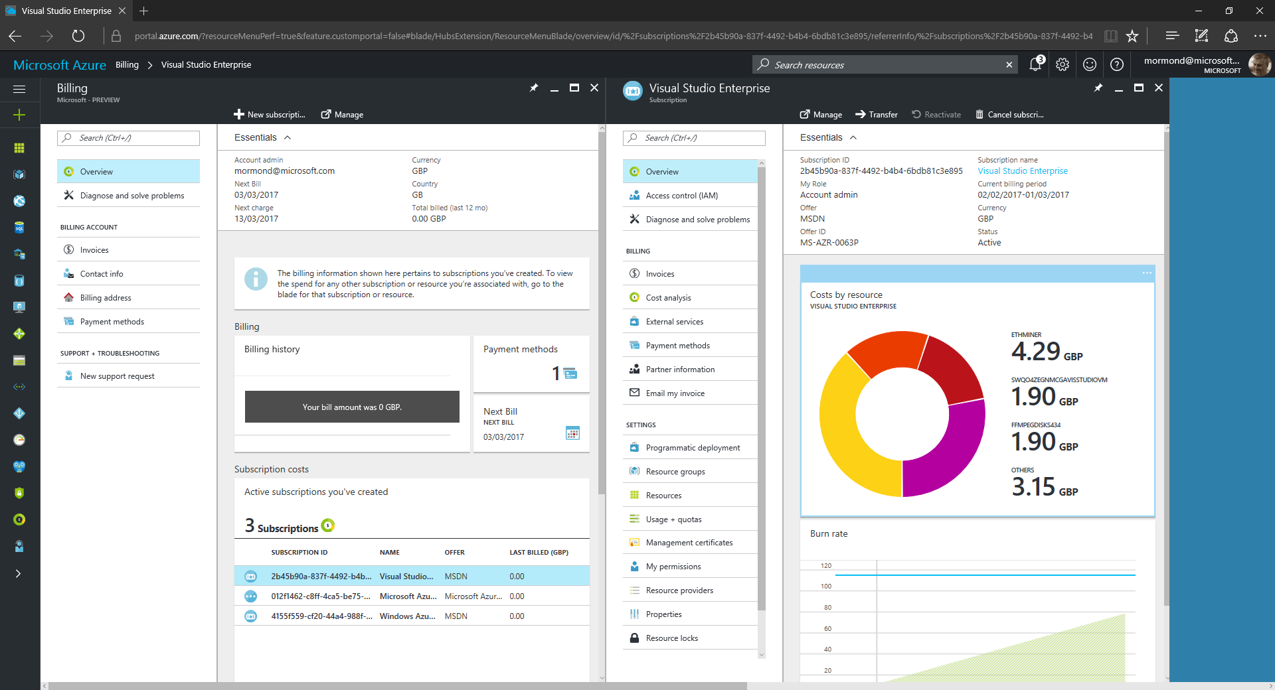
4
1
3
2

Slide 28
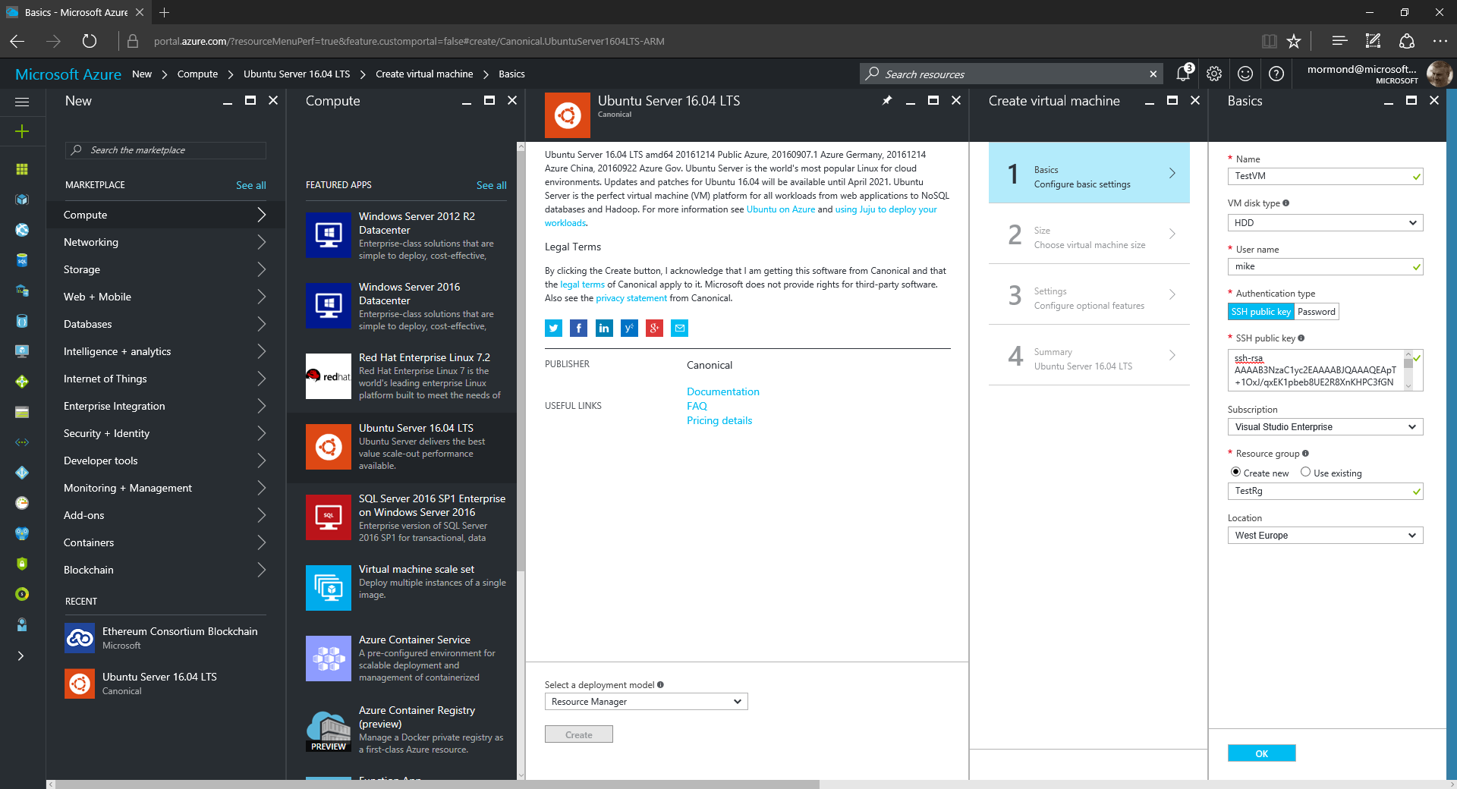
1
2
5
3
4
6

Slide 29
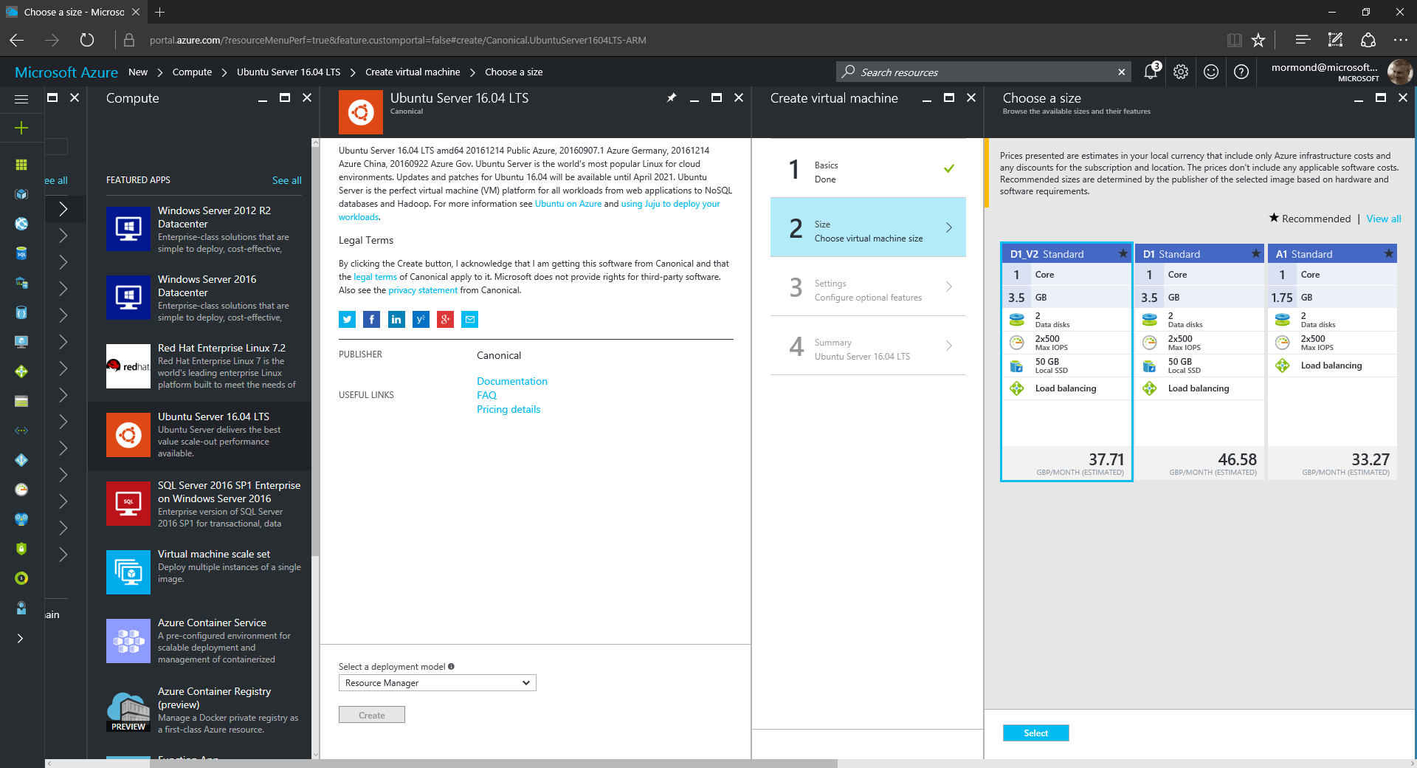

Slide 30
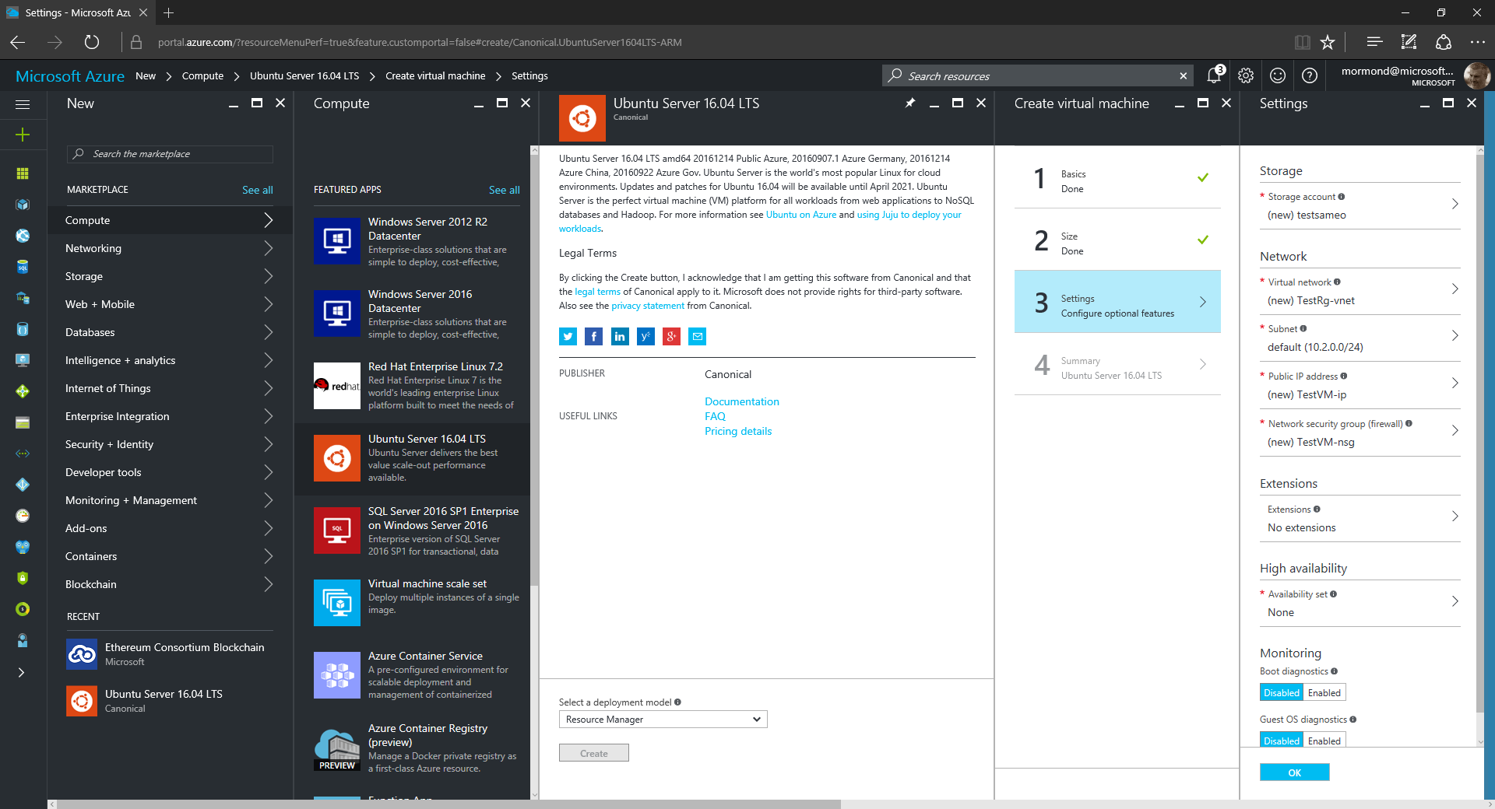

Slide 31
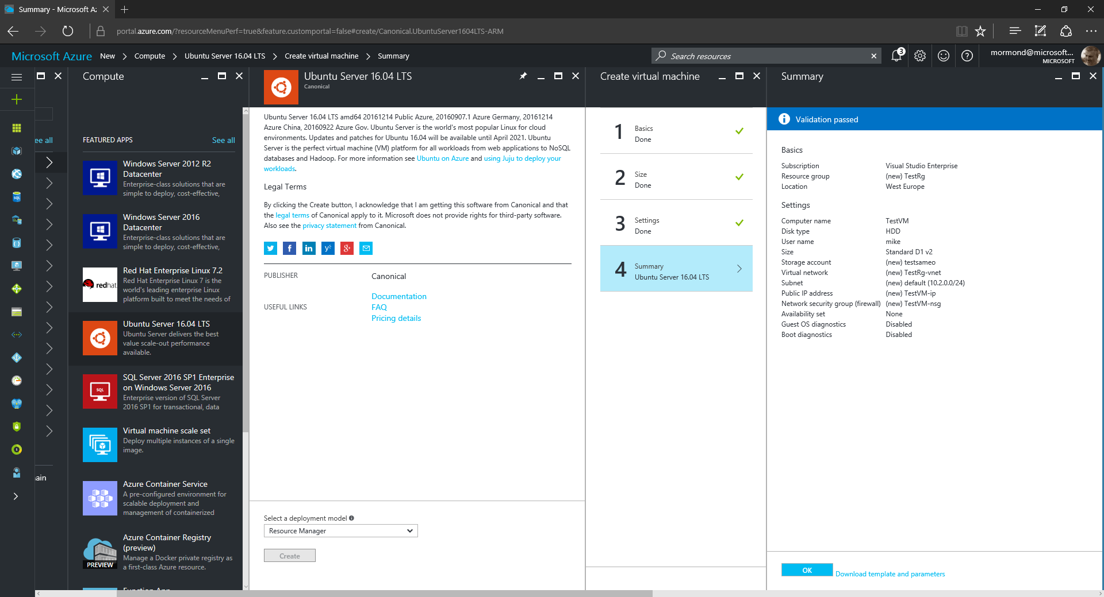

Slide 32
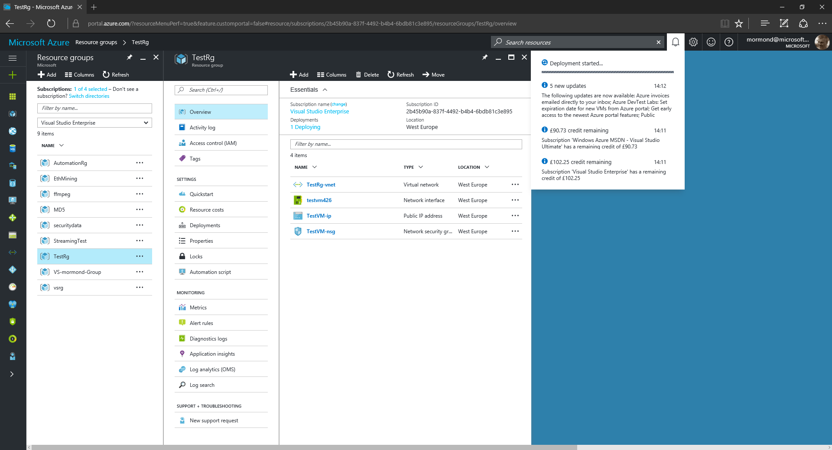
2
1

Slide 33
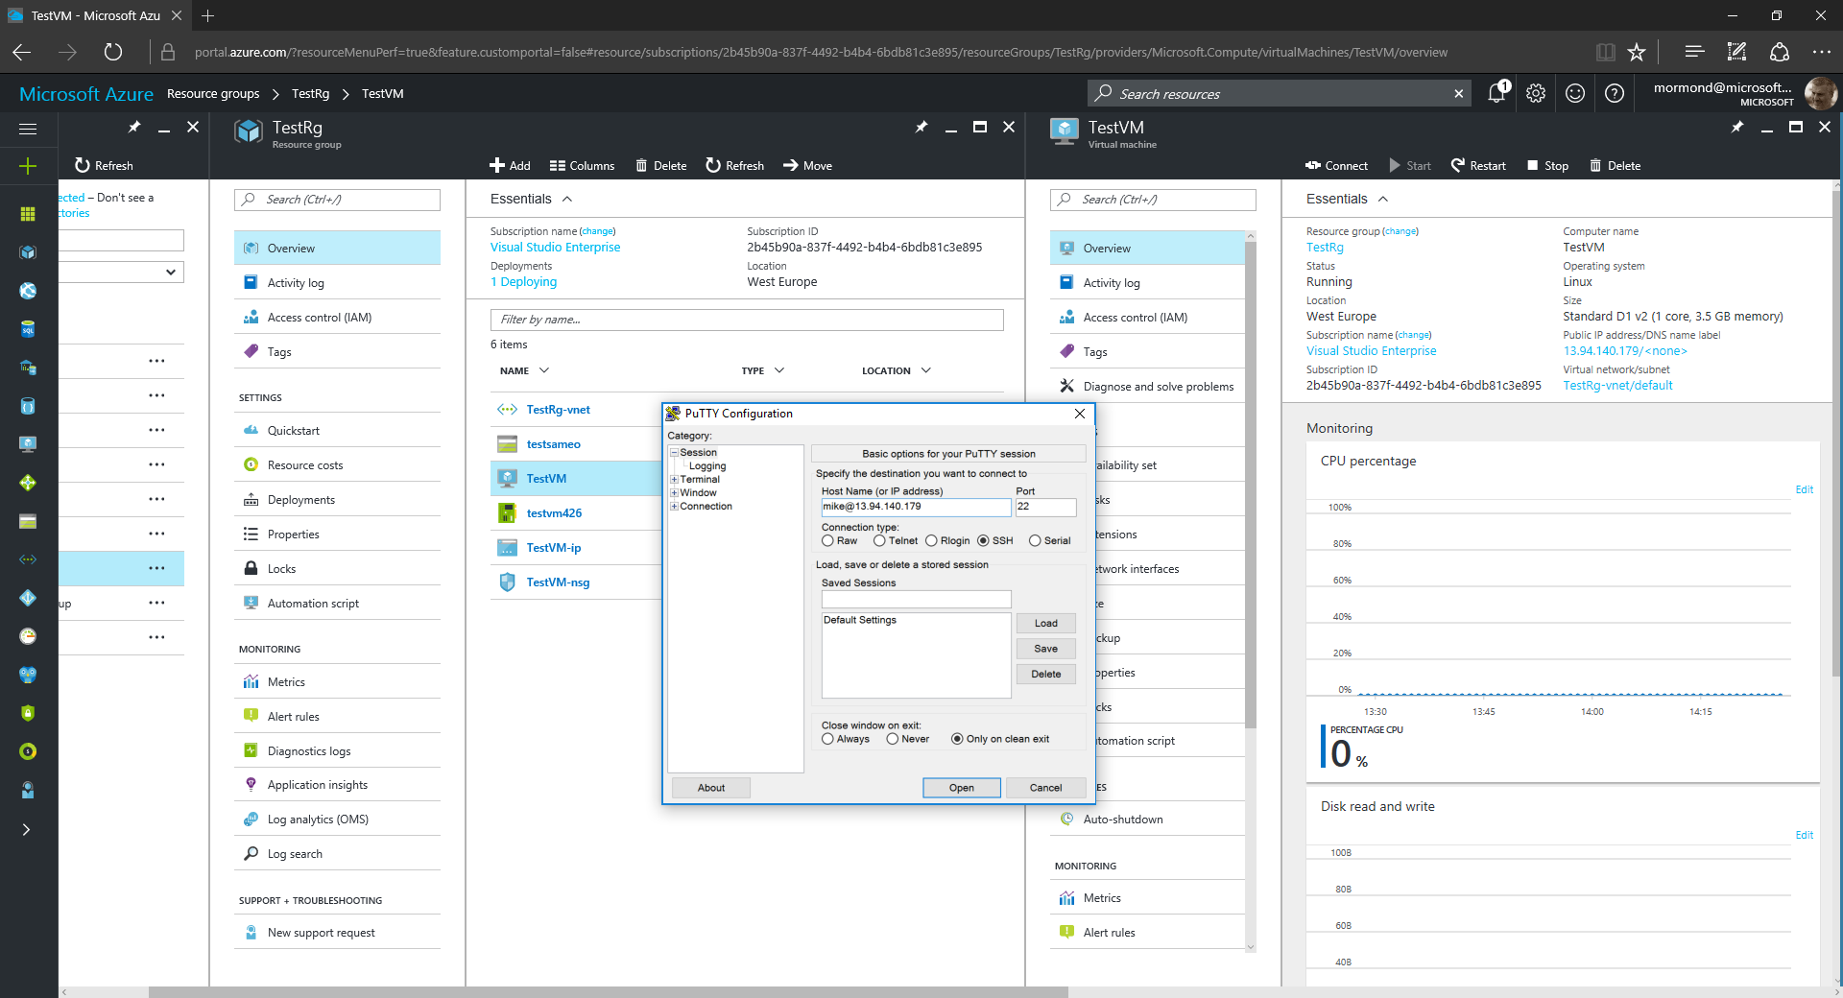

Slide 34
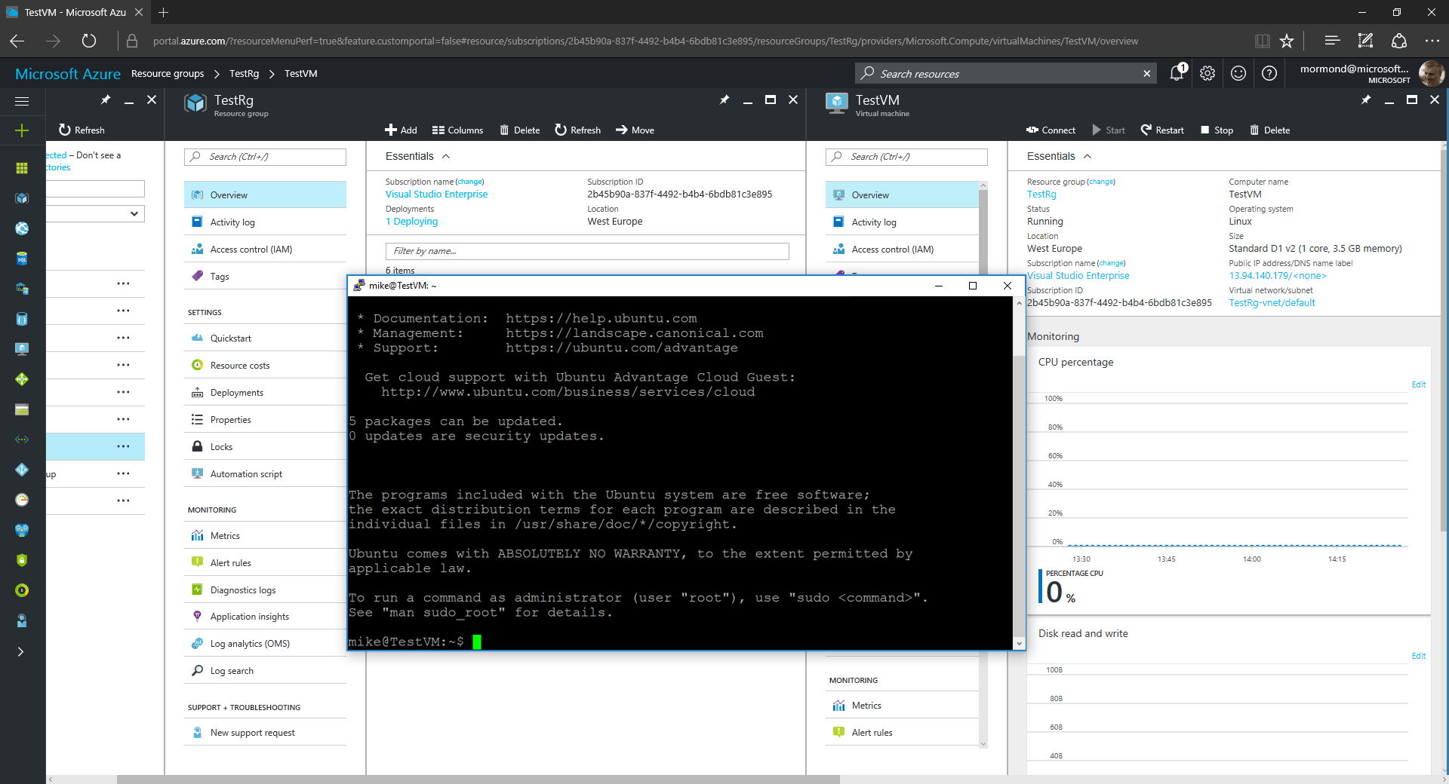

Slide 35
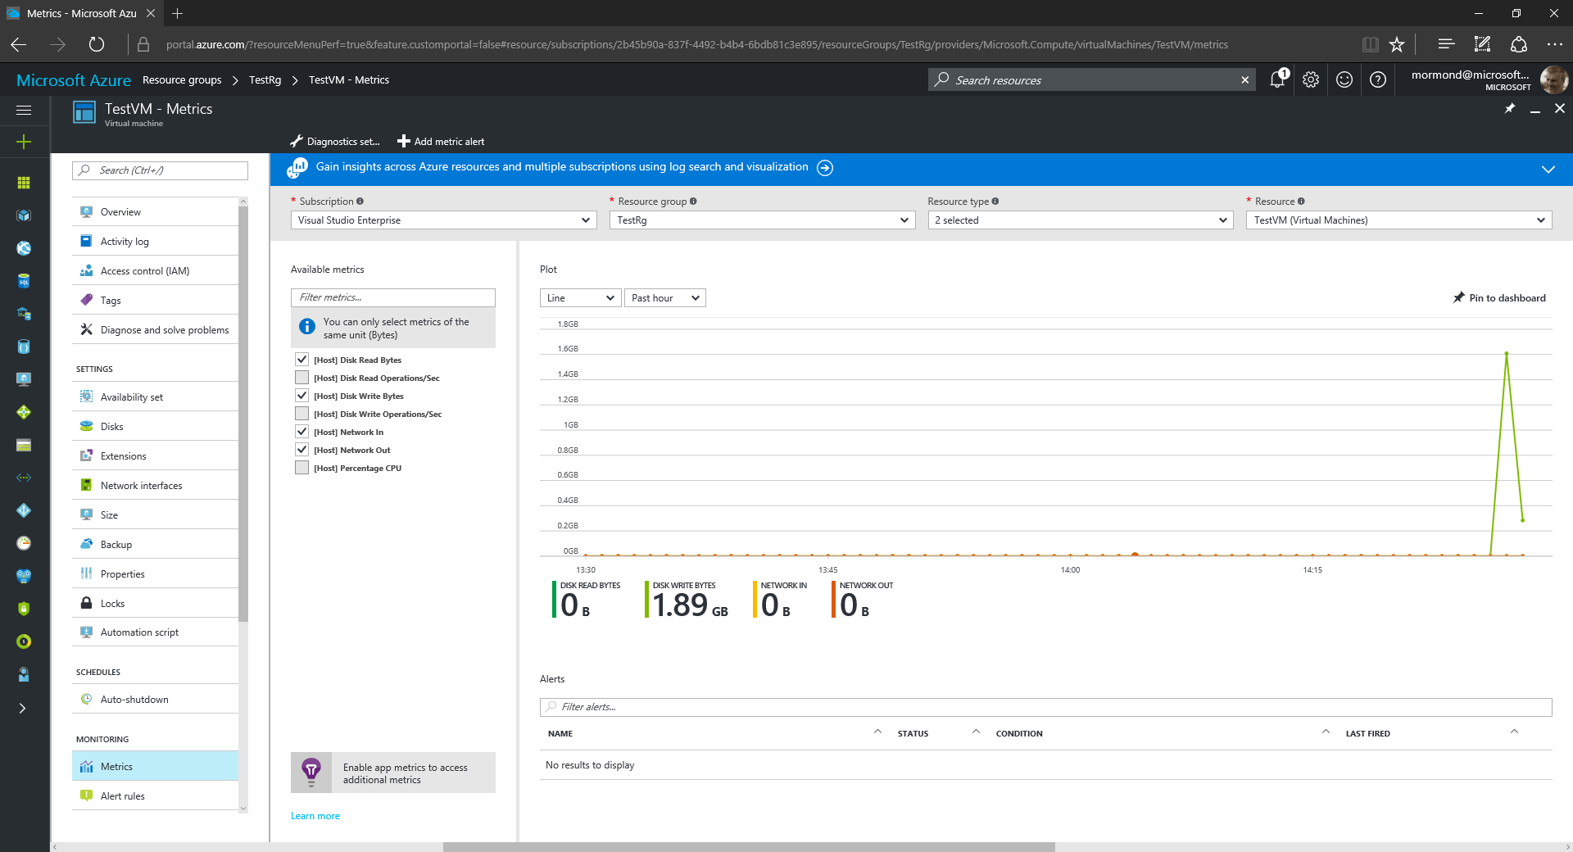

Slide 36
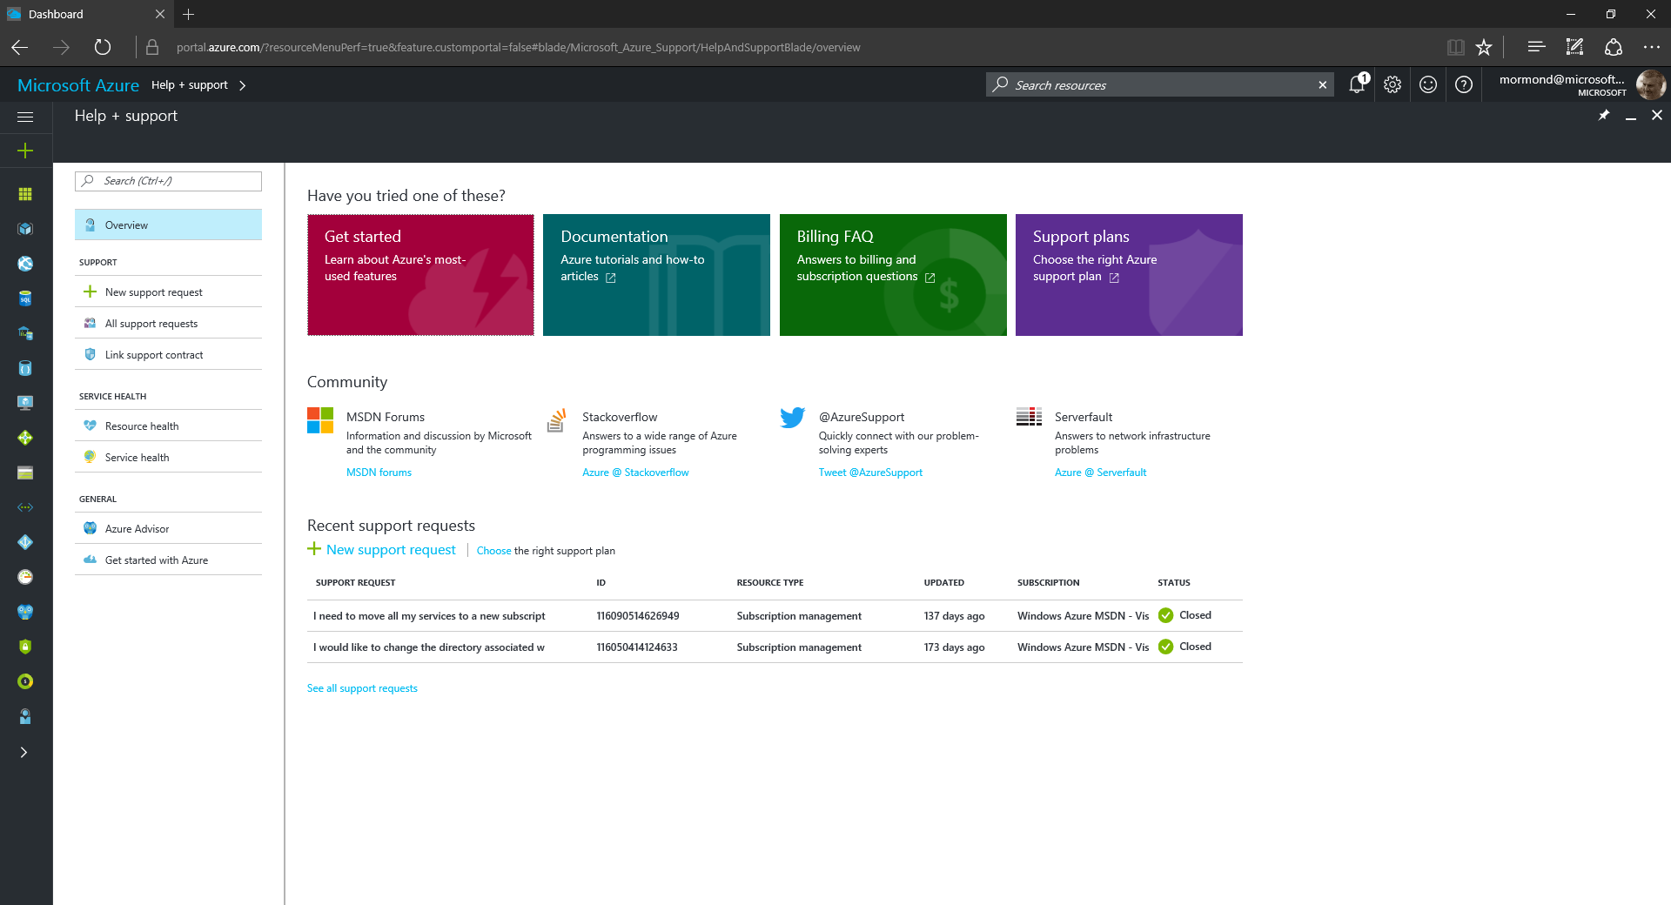
1
2

Slide 37
Summary

Slide 38
Useful resources
azure.microsoft.com is your starting place
azure.microsoft.com/free for your free trial
channel9.msdn.com/shows/Cloud+Cover &
channel9.msdn.com/Shows/Azure-Friday for great videos
azure.microsoft.com/blog for latest news

Slide 39
Thank you

